Slide 1
Following luminous novae with SALT into quiescence
Marina Orio, U-Wisconsin and INAF-Padova, Pretoria
With Polina Zemko, Stefano Ciroi & other collaborators
November 2018

Slide 2
Connecting outburst and quiescence properties of novae: optical and X-rays
Classical novae outbursts are due to thermonuclear runaways on accreting white dwarfs, both in CV-type systems (orbital periods hours to… 2 days?) and in symbiotics (red giant companions, orbital periods ~1 year
In all cases, the properties of the outburst are largely determined by m(WD), mdot, WD thermal status and its chemical composition (CO vs. ONe)
But…what about the magnetic field? 20-25% of CVs host “magnetic WDs” (B>10⁵ Gauss)
A large part of the SALT work presented here is published in Zemko et al. 2018, MNRAS, 480, 4489
New observations planned for N SMC 2016 (mainly, establish SMC membership, because if so it was so intrinsically luminous) and V407 Lup (an IP) as they return to quiescence

Slide 3
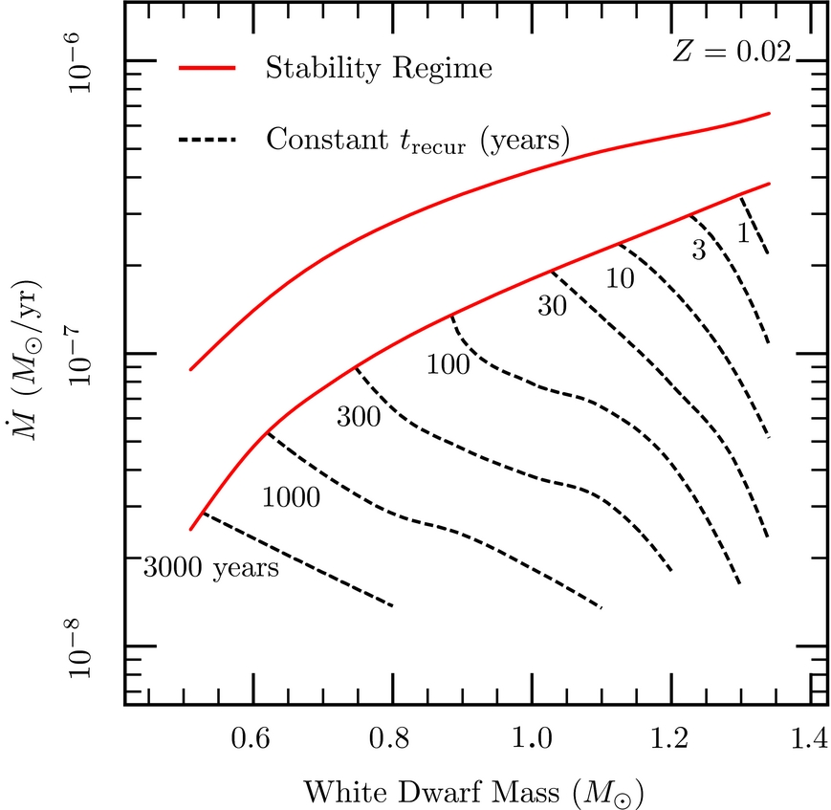
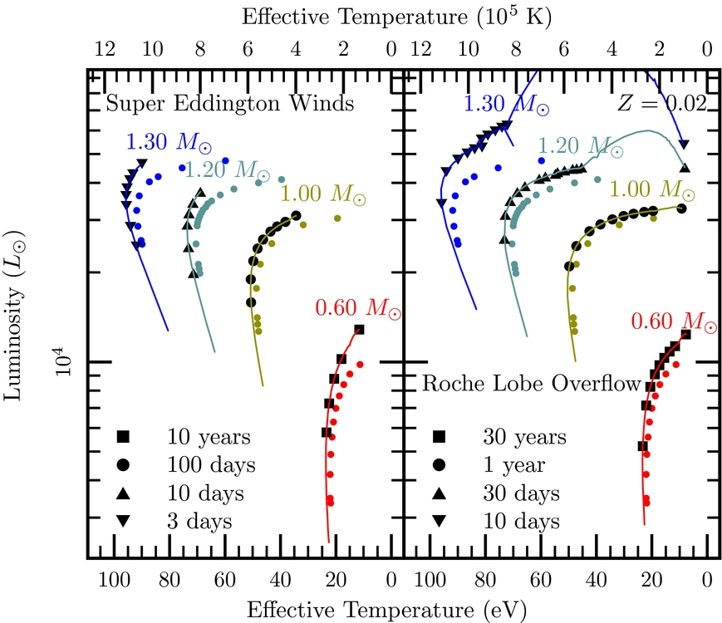
Accretion and nuclear burning: the parameters
Fujimoto et al. 1982
Wolf et al. 2013
Wolf et al. 2012 (similar results from other authors)

Slide 4
How about the WD magnetic field?
Only one “polar” ( B ~ few x 10⁶ Gauss, with magnetically driven accretion to the poles, is know: V1500 Cyg
Intermediate polars (IPs) are those with up to 10 times lower B and a disk is formed, but it is disrupted
Polars and IPs are 20-25% of all CVs
Are IPs frequent among novae? We now think so (GK Per, DQ Her, V4743 Cyg, V842 Cen, V2491 Cyg, V407 Lup…)
But should convection not be inhibited (Livio et al. 1988), therefore hindering the outburst?
Are “magnetic novae” slower (inhibition of shear mixing, Livio et al. 1988) or faster (magnetic rotator effects. Orio et al. 1992)?

Slide 5
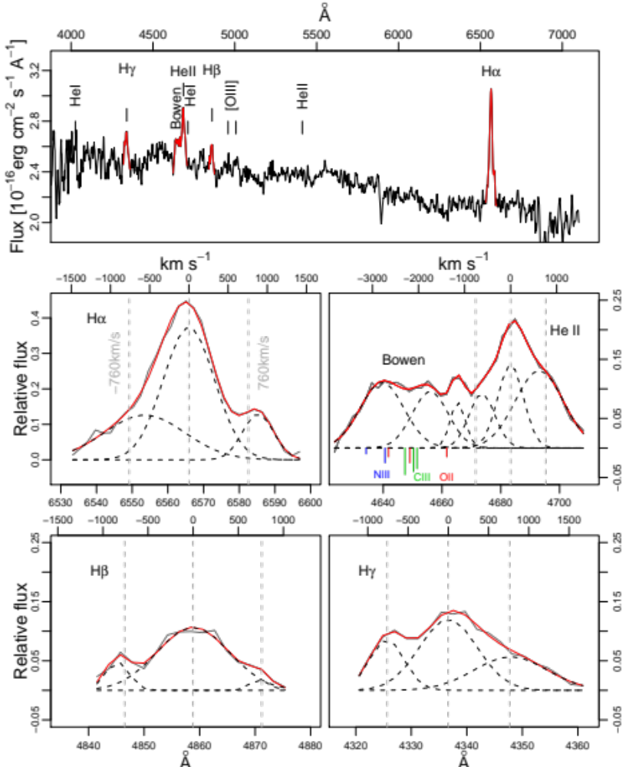
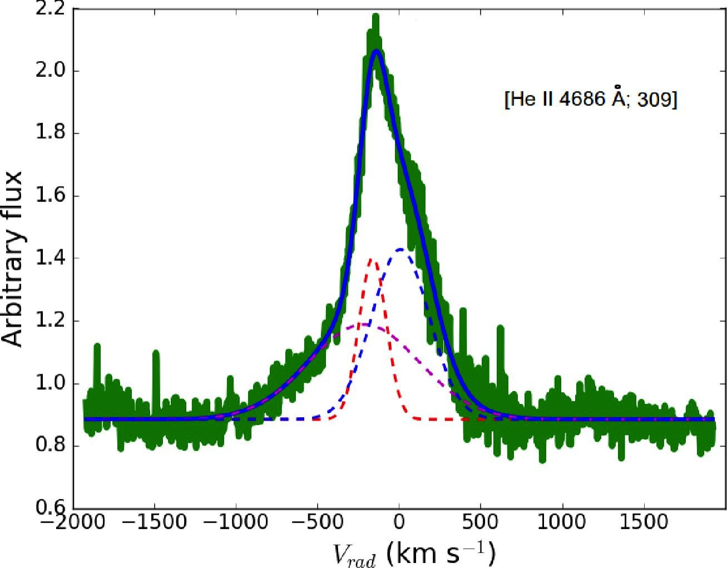
Observing magnetic novae with SALT: line profiles with two or more components
Left: V407 Lup in Outburst (Aydi et al. 2018)
Right: V2491 Cyg with the BTA

Slide 6
Effects of irradiation of the supersoft X-ray source
Like Ringwald et al. (1996) , and Tomov et al. with SALT (2015) we looked at the variation of the EW of the He II λ4686 line and the Bowen complex with respect to Hβ
Our sample is only composed of recent novae, and most were luminous SSS for a while (very hot H-burning WD)
No clear correlation indicating variation of the hot continuum within few years
No correlation with orbital period indicating irradiation is strong in short orbital period systems

Slide 7
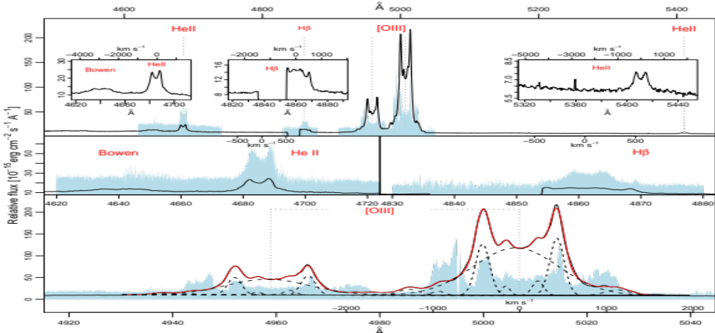
T Pyx: fragmentation of the shell
(evolution 2012-2014, RSS vs. HRS in blue)

Slide 8
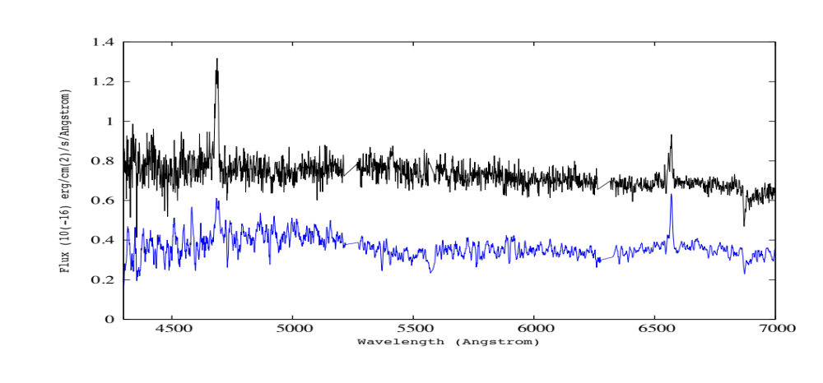
U Sco: very little hydrogen?
These two spectra were taken at different orbital phase, see changing He II intensity

Slide 9
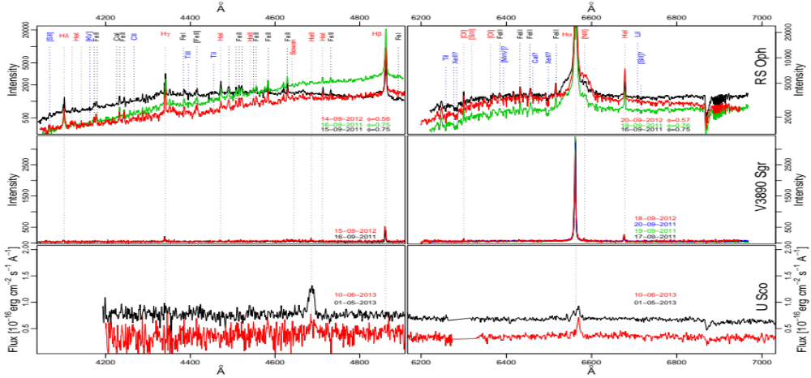
Symbiotic novae: no coronal lines in RS Oph and V3890 Sgr

Slide 10
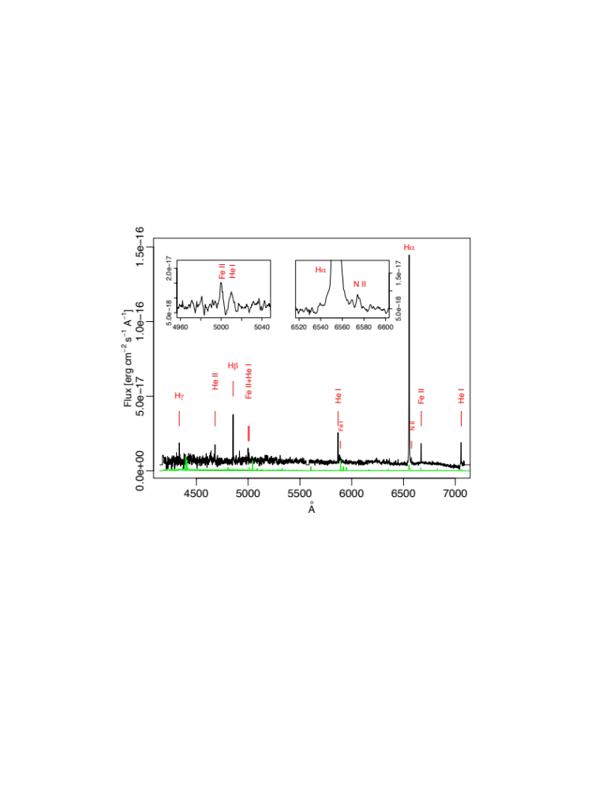
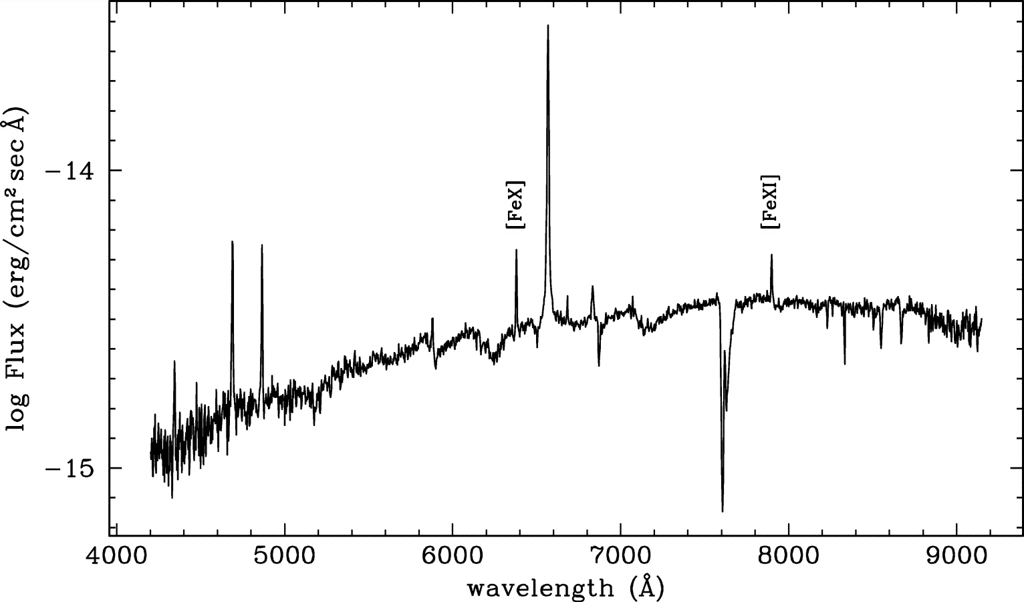
Are symbiotic novae accreting intermittently?
Coronal lines are usually observed in H-burning symbiotics like SMC 3
But… see example of a very weird symbiotic in M31 (hydrogen burning “r3-8”) and compare with SMC 3 (density effect!?)

Slide 11
Summary and future plans
Following novae into quiescence in X-RAYS AND OPTICAL is essential to understand their characteristics and evolution and effect of irradiation on mass transfer cycles
We started finding evidence (timing in optical and X-rays) of several IPs among novae. SALT spectra should become instrumental in understanding the geometry of the systems
Recurrent novae do not appear to be accreting at significantly high rate for an inter-outburst period: intermittent accretion rate?
More work can be done with SALT on U Sco: phase dependent line ratio?
Apparent early fragmentation of the T Pyx shell
New work is in progress to find evidence of mass accretion rate and of magnetic field in recent novae, and assess SMC membership of the super-luminous nova SMC 2016a

